Slide 1
Welcome to Larks Class! 2024 - 2025

Slide 2
Staff in Larks Class
Mrs Masson is in class Mondays, Tuesdays, Wednesdays and some Thursdays.
Mrs Lockwood is in class some Thursdays and Fridays.
Mrs Lloyd takes the pupils for Forest Schools on Wednesday afternoons.
Mrs Shelley Moore is the Class Teaching Assistant who is with Larks every day.

Slide 3
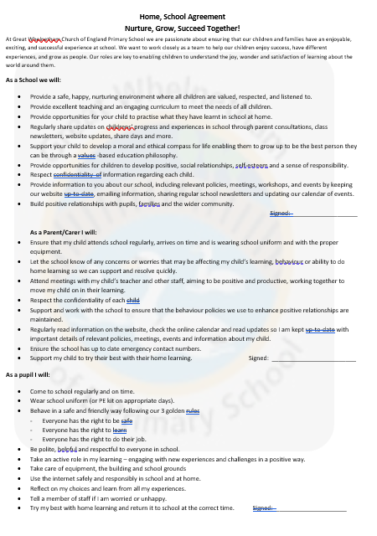
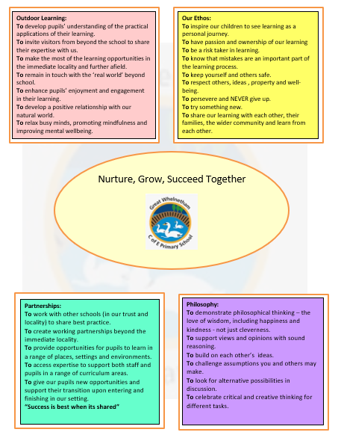

Slide 4
Larks Timetable

Slide 5
Time Table
English and Maths is taught every day in the mornings.
Spelling activities and Phonics are taught daily.
Maths Meetings will hopefully take place 4 times a week, just after lunch.
Topic learning will change every three weeks – this half term we will be learning about History and Design and Technology.
Our focus in History is ‘Amazing Me’ – can I request a baby photo please!
In Design and Technology our learning is based around Cooking and Nutrition: Making a Stir fry!
Daily ‘Wellbeing Pit stops’ take place throughout the school day to develop focus and concentration with opportunities to learn strategies for feeling calm and relaxed.

Slide 6
Learning in Larks Class
Our curriculum is designed around learning key skills and knowledge and understanding.
We will learn in lots of different ways – active/practical activities, independent tasks and collaborative tasks.
Children will work as a class, with partners, in small groups as well as independently.
Many learning opportunities are shared through the school website and Facebook page.

Slide 7
Reading in Larks Class
We aim to hear each child read at least once a week.
We read and share stories in class daily.
Every week the pupils take part in an extended reading lesson.
Pupils have the opportunity to visit our book corner’s throughout the school day accessing a wide range of reading books.
Pupils visit the library once a week to explore and choose a library book to borrow.
Pupils also have the opportunity to borrow a ‘Reading for Pleasure’ book.

Slide 8
Assessment for Learning
Children’s work in books are marked and feedback/next steps will be given.
Verbal feedback is given within lessons – live marking.
Year 1 children will complete a phonics assessment each term in preparation for their Phonics test in June 2025. Year 1 children will take a maths and reading assessment in the Summer term.
Children will complete independent writing tasks throughout the year which will be assessed.
The assessments above will give us an indication of whether your child is working towards the expected level, at the expected level or at a greater depth level in each subject.
Reception children will have a Baseline Assessment within 6 weeks of starting school. This will give us an indication of their starting point – all assessments are made through careful tracking and Teacher Assessment observations .

Slide 9
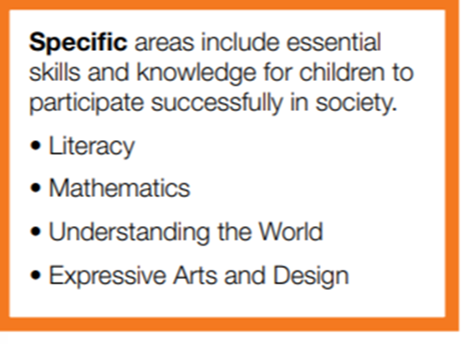
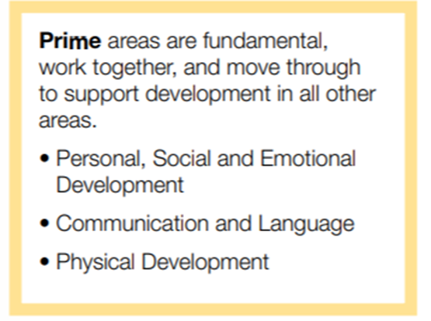
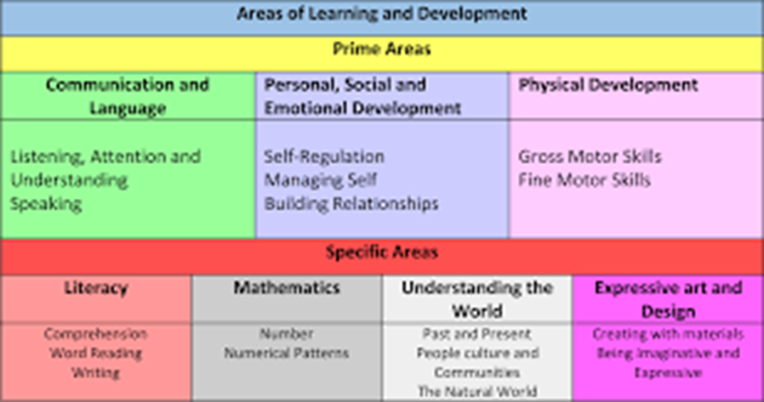
Early Years Curriculum – 7 areas 17 ELG’s

Slide 10
Observations and photos are uploaded for you to see a snapshot of your child’s learning and journey in their first year in school…

Slide 11
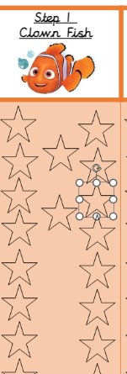
Homework
Reading:
Your child should have a reading book which they should be reading at home and should be brought to school each day. They should be reading 5 times a week at home, this should be for just 5-10 minutes.
Please do comment in their reading diary in the home section. These are usually checked in school daily.
The Reading Challenge for this year has begun with an under the sea theme. Each time you hear your child read please date and initial a star in their bookmark.
Once your child has completed a bookmark we will move them onto the next stage. They will be rewarded with 10 house points!

Slide 12
Homework
Spelling:
Given out on a Monday.
We spend time in class learning the digraphs/graphemes and practising the words throughout the week.
Please do support your child in practising these at home.
The children will be tested the following Monday (their score will be written in their reading record under their spelling sticker each week).

Slide 13
Friendly reminders
In the morning, please encourage your child to bring their own book bag into school, putting reading books and reading diaries into the correct boxes, developing independence skills.
All children need a water bottle in school every day. Please send them in on a Monday and we will send them home on a Friday for cleaning.
Please make sure your child has a coat, and all school uniform is labelled – if any items go missing, we can make sure they are returned to the right families.
We suggest P.E. kits are in school all of the time.

Slide 14
Throughout the year, if you have any questions, concerns or would like to discuss any matters, there are a different ways you can contact me:
Before or after school at the classroom door
Please telephone the school to arrange a phone call or meeting
Email the school – c.masson@greatwhelnethamprimary.org.uk

