Slide 1

Welcome to
Robins Class!
2024-2025

Slide 2

Staff in Robins Class
Miss Tyler is in class Mondays, Tuesdays, Thursdays and Fridays.
Mrs Lloyd takes the pupils for Forest Schools on Wednesday afternoons.
Mrs Reavis teaches the pupils on Wednesday afternoons.
Mrs Coral Milner is the Class Teaching Assistant who is with Robins every day.

Slide 3
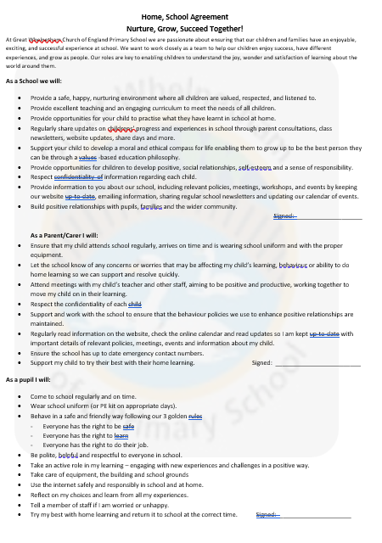
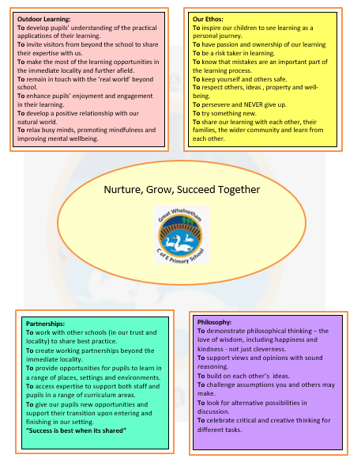

Slide 4
Robins Timetable

Slide 5
Time Table
English and Maths is taught mostly in the mornings.
Spelling activities and Phonics are taught at least 3 times a week.
Maths Meetings take place 4 times a week.
Topic learning will change every three weeks – this half term we will be learning about History and Design and Technology.
Our focus in History is ‘The Gunpowder Plot’.
In Design and Technology our learning is based around ‘Making a Vehicle’.
Daily ‘Wellbeing Pit stops’ take place throughout the school day to develop focus and concentration with opportunities to learn strategies for feeling calm and relaxed.

Slide 6
Learning in Robins Class
Our curriculum is designed around learning key skills and knowledge and understanding.
We learn in lots of different ways – active/practical activities, independent tasks and collaborative group tasks.
Children will work as a class, with partners, in small groups as well as independently.
Many varied learning opportunities are shared through the school website and Facebook page.

Slide 7
School Trips in Robins Class
In Robins we will be taking part in a range of trips across the year. These enable our pupils to extend and enrich their learning experiences.
AUTUMN TERM:
Trip to Abbeygate Sixth Form College, Escalator Day – Thursday 10th October
We often require volunteers for school trips, if you think you might be able to help, do let me know.

Slide 8
Reading in Robins Class
We aim to hear each child read at least once a week.
We encourage Y2 pupils and some Y3 pupils to read books twice through to develop word recognition, understanding and improved confidence.
We read and share stories in class daily.
Every week the pupils take part in an extended reading lesson.
Pupils have the opportunity to visit our book corner throughout the school day accessing a wide range of reading books.
Y2 pupils also have the opportunity to borrow a ‘Reading for Pleasure’ book. These will be given out this week.
School library will be open to families on a Friday afternoon, after school.

Slide 9
Assessment for Learning
Children’s work in books are marked and feedback/next steps will be given.
Verbal feedback is given within lessons.
Children will complete a maths, reading and SPaG assessment at the end of each term.
Children will complete independent writing tasks throughout the year which will be assessed.
The assessments above will give us an indication of whether your child is working towards the expected level, at the expected level or at a greater depth level in each subject.
In May, Year 2 pupils will be taking in the Optional End of Key Stage 1 tests in Reading, SPaG and Maths
Year 2 pupils who did not pass their Phonics test in Year 1 will re-take the test in June.

Slide 10
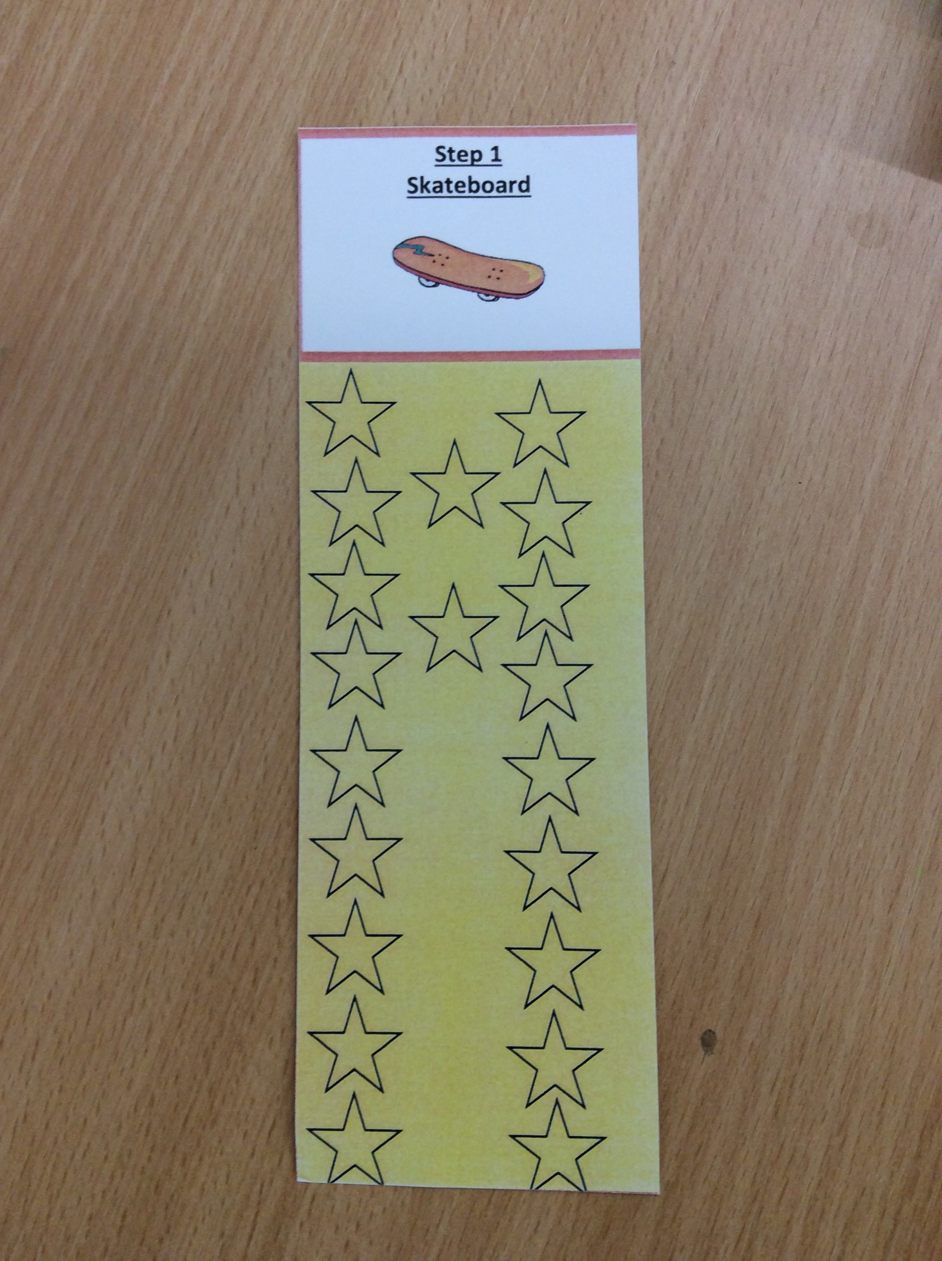
Homework
Reading:
Your child should have a reading book which they should be reading at home and should be brought to school each day. They should be reading 5 times a week at home, this should be for just 5-10 minutes.
Please do comment in their reading diary in the home section. These are usually checked in school daily.
The Reading Challenge for this year has begun with an ‘under the sea’ theme. Each time you hear your child read please date and initial a star in their bookmark.
Once your child has completed a bookmark we will move them onto the next stage. They will be rewarded with 10 house points!

Slide 11
Homework
Spelling:
Given out on a Monday.
We spend time in class learning the spelling rule and practising the words throughout the week.
Please do encourage your child to practice their weekly spellings on ‘Spelling Shed’ the new spelling pattern will be updated each Monday.
The children will be tested on a Friday (their score will be written in their reading record under their spelling sticker each week).

Slide 12
Homework continued…
Maths Homework
The children will be set homework on a Friday in their Maths Practice Journal and this is due in by the following Thursday.
Homework should be completed in their homework books in pencil. Each activity is based on their learning in school encouraging the children to practice and reinforce skills.
On some occasions, pupils may have particular questions highlighted, please encourage your child to complete the questions first.
We encourage you to support your child in completing these activities.
We do not expect children not to spend more than 30 minutes on this weekly task.

Slide 13

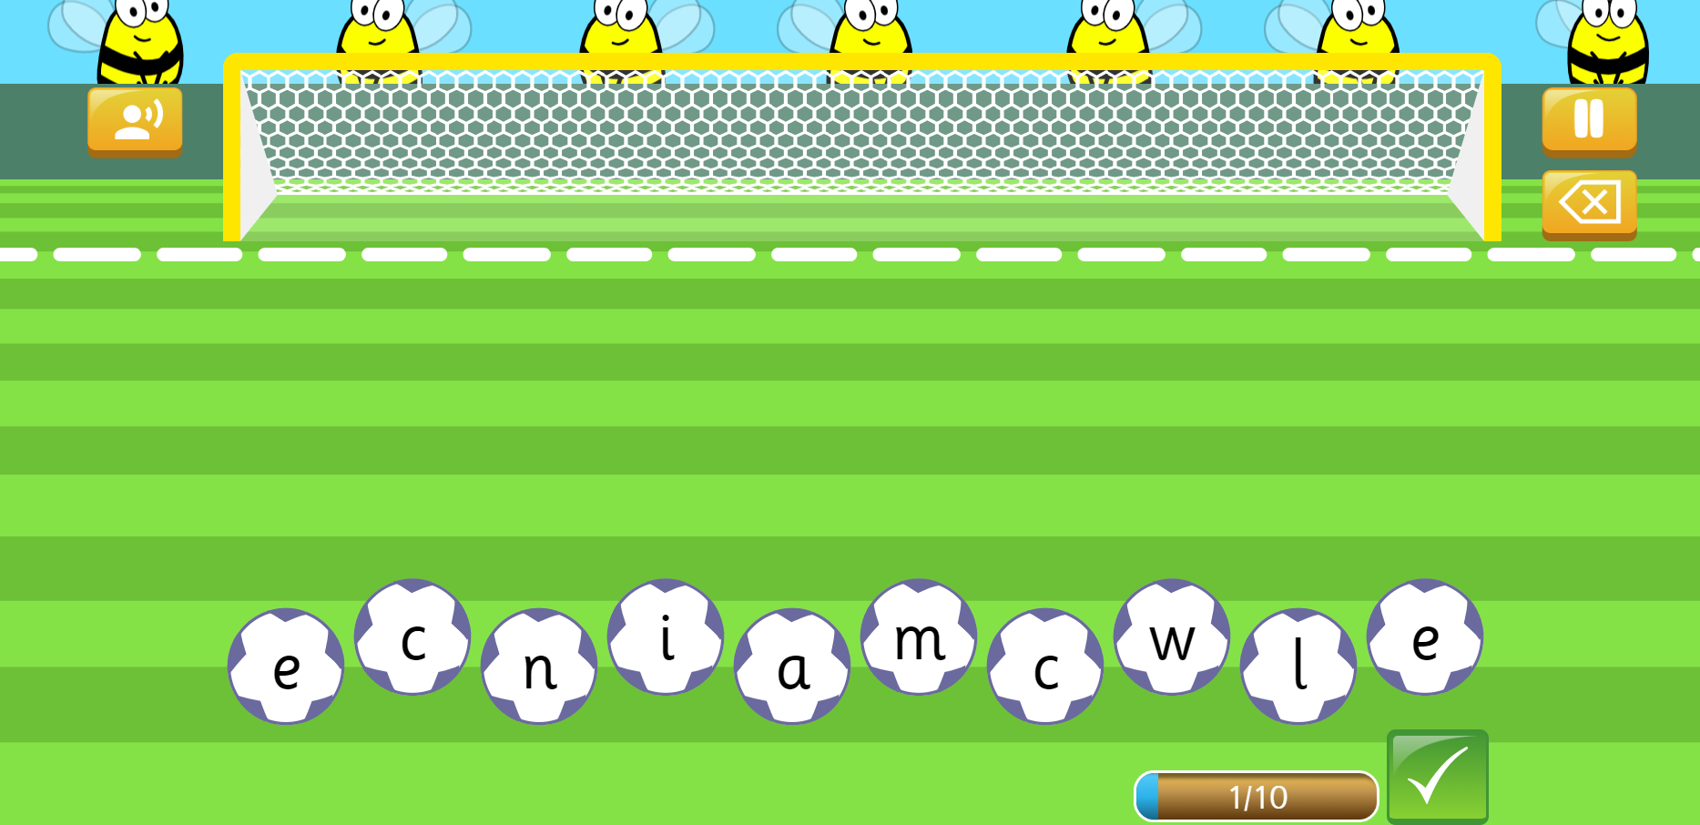
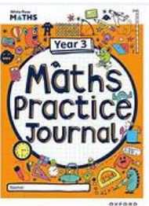

Slide 14
Friendly reminders
In the morning encourage your child to bring their own book bag into school, putting reading books and reading diaries into the correct coloured boxes, developing independence skills.
All children need a water bottle in school every day. Please send them in on a Monday and we will send them home on a Friday for cleaning.
Please make sure all school uniform is labelled – if any items go missing we can make sure they are returned to the right families.
We suggest P.E. kits are in school all of the time. P.E. days this term are on a Wednesday (Forest School) with Active Lunch Club on a Tuesday.

Slide 15
Throughout the year, if you have any questions, concerns or would like to discuss any matters, there are a different ways you can contact me:
Before or after school at the classroom door
Please telephone the school to arrange a phone call or meeting
Email the school – n.tyler@greatwhelnethamprimary.org.uk

Slide 16
