Slide 1
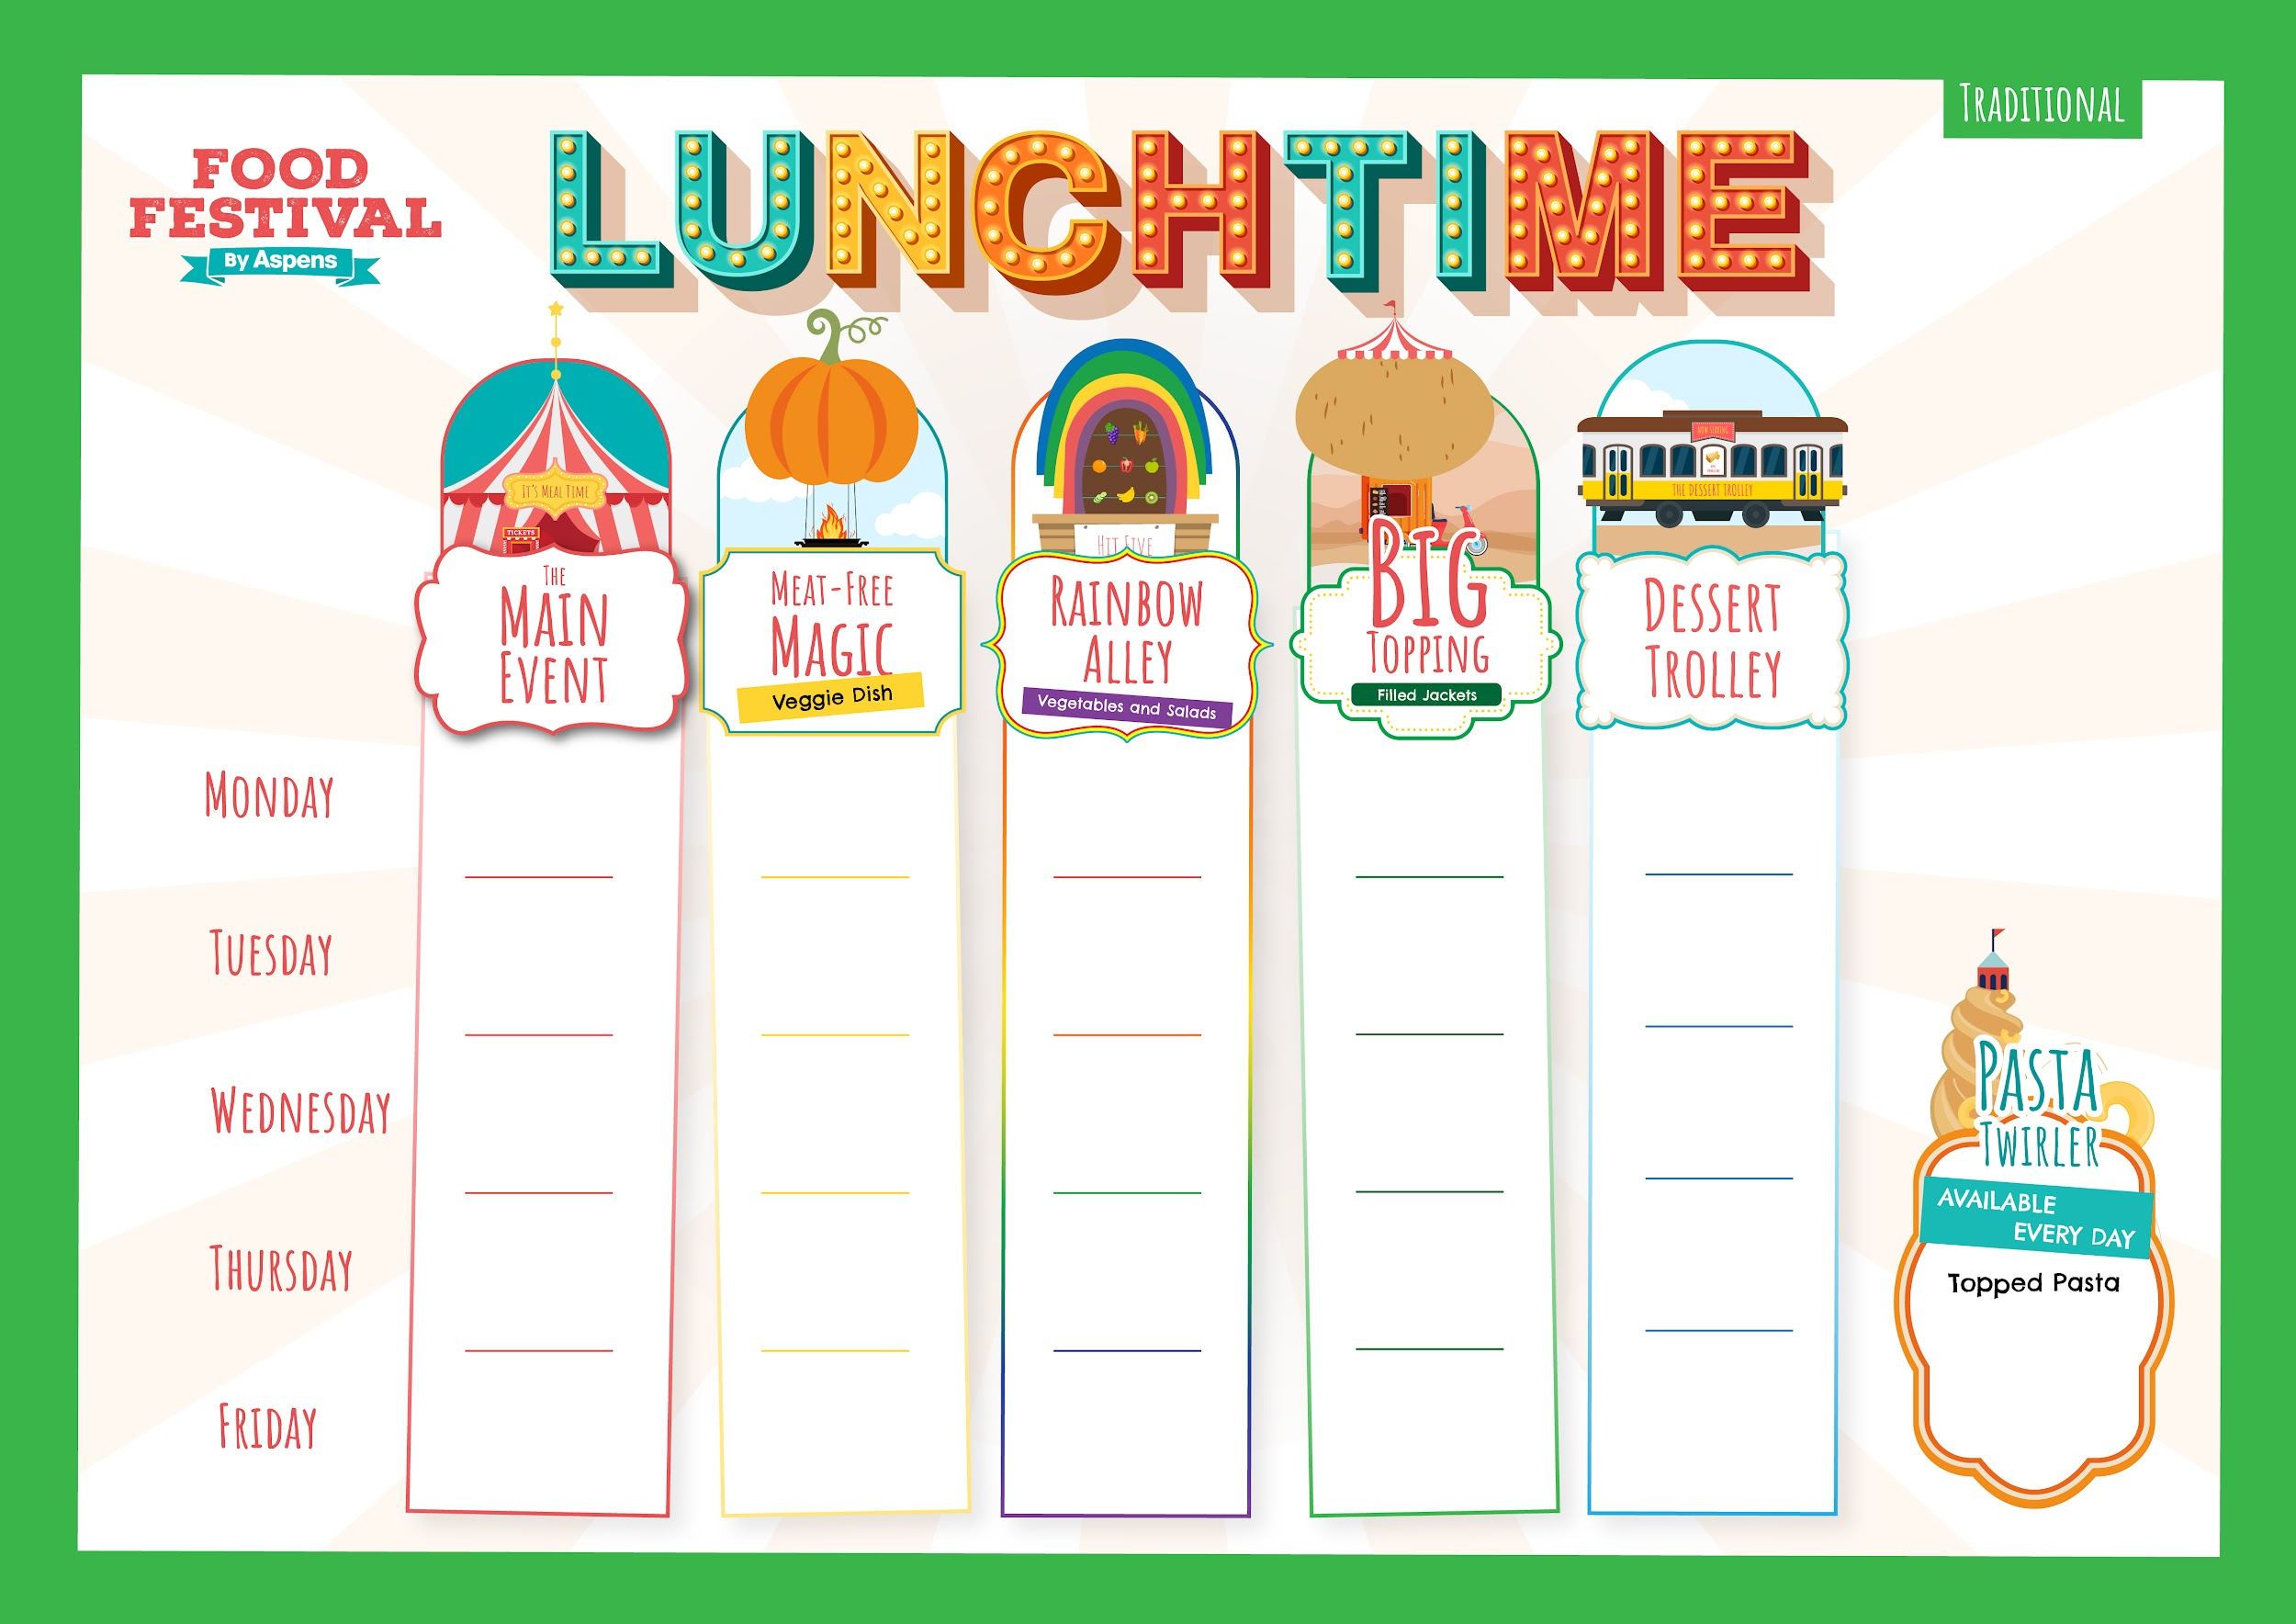
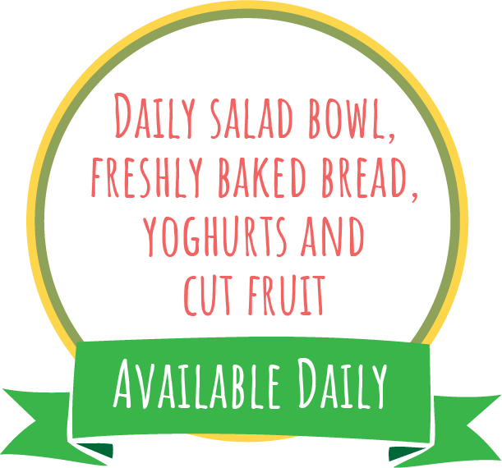
Week 1
Autumn Winter 2024-25:
2/9, 23/9, 14/10, 4/11, 25/11, 16/12, 6/1, 27/1, 17/2, 10/3, 31/3
Margherita
Pizza
Slice and Wedges
Veggie Pepper and Sweetcorn Pizza Slice with Wedges
Sweetcorn
Beans,
Cheese or
Tuna Mayo
Toffee Frozen Yoghurt
BBQ Cheesy Chicken
Butterbean Ratatouille
Apple Slaw and Wholegrain Rice
Beans,
Cheese or
Tuna Mayo
Sweet Potato Brownie
Roast Gammon,
Roast Potatoes and Gravy
Quorn Sausage,
Roast Potatoes and Gravy
Beans,
Cheese or
Tuna Mayo
Forest Fruits Jelly Pots
Peas and Carrots
Lasagne
Vegetable Lasagne
Green Beans
Beans,
Cheese or
Tuna Mayo
Cookie Dough Apple Crumble
Hot Pasta topped with Homemade
Tomato Sauce and Cheese
Golden Fish Fingers or
Salmon Fingers
and Chips
Veggie Burger and Chips
Beans,
Cheese or
Tuna Mayo
Jammy Thumbprint Biscuits
Baked
Beans
T1

Slide 2
Week 2
Autumn Winter 2024-25:
9/9, 30/9, 21/10, 11/1, 2/12, 23/12, 13/1, 3/2, 24/2, 17/3, 7/4
Cheesy Tomato Pizza
BBQ and Sweetcorn
Pizza Slice
Wholegrain Pasta Salad and Green salad
Beans,
Cheese or
Tuna Mayo
Toffee Apple Sponge and Custard
All Day Breakfast
Vegetarian All Day Breakfast
Hash Brown and Baked Beans
Beans,
Cheese or
Tuna Mayo
Chocolate Sprinkle Iced Cake
Roast Pork,
Roast Potatoes and Gravy
Cauliflower Cheese, Crispy Onion Topping & Roast Potatoes
(You don’t have to have the onions)!
Beans,
Cheese or
Tuna Mayo
Mixed
Greens
Raspberry Coconut Jelly
Classic
Cottage
Pie
Roasted Sweet Potato Pastry Roll and Mash
Peas
Beans,
Cheese or
Tuna Mayo
Fresh Fruit Salad
Hot Pasta topped with Homemade
Tomato Sauce & Cheese
Battered Fish
and Chips
Cheese and Tomato Toasted Wrap with Chips
Beans,
Cheese or
Tuna Mayo
Anzac Biscuits
Baked
Beans
T1

Slide 3
Week 3
Autumn Winter 2024-25:
16/9, 7/10, 28/10, 18/11, 9/12, 30/12, 20/1, 10/2, 3/3, 24/3
American Style Mac Cheese
Veggie Wholegrain Pasta Bolognese
Carrots
Beans,
Cheese or
Tuna Mayo
Marble
Cake
Sausage Casserole and Mash
Vegetable Pot Pie
and Mash
Roast Root Veggies
Beans,
Cheese or
Tuna Mayo
Apple, Cinnamon Raisin Flapjacks
Roast Chicken, Stuffing,
Roast Potatoes and Gravy
Carrot and Stuffing Pastry Plait
Beans,
Cheese or
Tuna Mayo
Orange and Mango Jelly
Peas and Sweetcorn
Meatballs in Tomato Sauce with Rice
Mild Veggie Bean Chilli Loaded Wedges with Cheese
Broccoli
Beans,
Cheese or
Tuna Mayo
Banana Bread Muffins
Hot Pasta topped with Homemade
Tomato Sauce & Cheese
Golden Fish Fingers
and Chips
Vegetable Fingers
and Chips
Beans,
Cheese or
Tuna Mayo
Gingerbread Cookies
Baked
Beans
T1

